Slide 1

Maryland Capital Grantees Workshop
“Demystifying the Capital Grants Process”
Capital Grants & Loans Division

Slide 2
“Demystifying the Capital Grants Process”
Presented by
The DGS Capital Grants & Loans Program Office
Capital Grants and Loans Program – a Legislative Initiative
Pre-Authorization
Post-Authorization
Capital Grants Application Process
  Step 1 – Capital Grant Project Application Package distribution
    Capital Grant Project Agreements – Policy Overview
    Matching Fund Certification
    Board of Public Works (BPW) Meeting
  Step 2 –Procurement and Contract Review Process
    Contractor Solicitation
    Contract Eligibility Letters
  Step 3 – Matching Fund and supporting documentation
  Step 4 – Request for Payments and submission of documentation
  Step 5—Project Close-out and Reporting
Grant Recipient Testimonial - Champ House Recovery
Questions & Answers

Slide 3
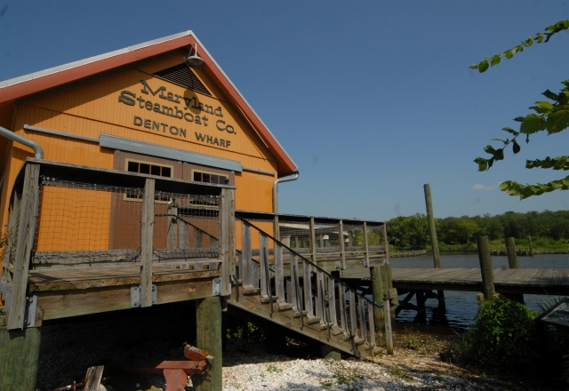

Capital Grants Overview
Funds for a grant may be sought/requested as a Legislative Bond Initiative​​ sponsored by a State Senator or Delegate or as an Administration initiative as part of the Maryland Consolidated Capital Bond Loan (MCCBL) or in the Governor's budget. A process chart has been prepared to provide an overview for the process used in obtaining and administering legislative grants. The process may at first appear to be complicated, but once the legislation is signed by the Governor, the entire process can be broken down into five steps.
Eligible participants include:
  Nonprofit Educational or Public-Health Institutions
  501(c )3 Nonprofit Organizations
  Maryland Registered Nonprofits
  Schools
  Institutions of Higher Learning
  County Governments and Municipalities

Slide 4
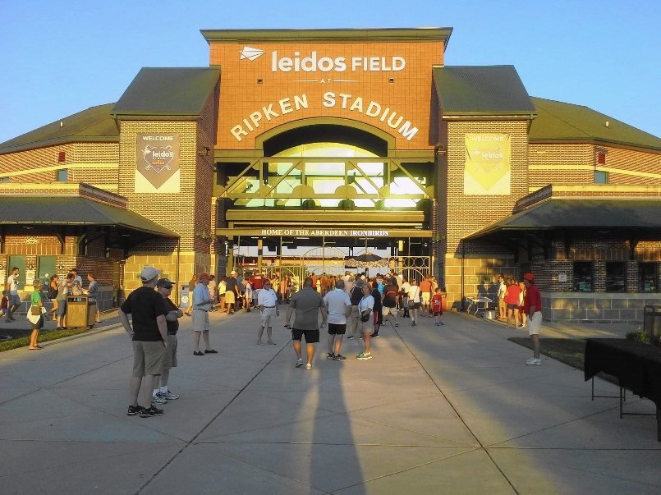


Capital Grants Overview
The projects that are funded offer benefits to local communities with a public purpose, and including :
Employment creation
Community development
Economic gain
Contracting opportunities for
  local businesses

Slide 5
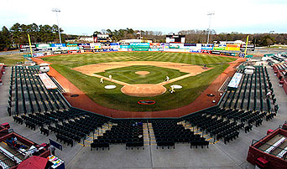
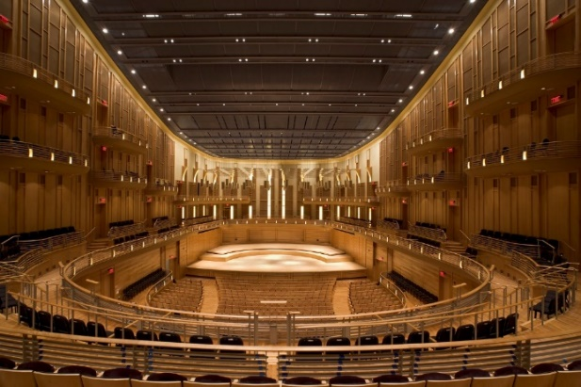
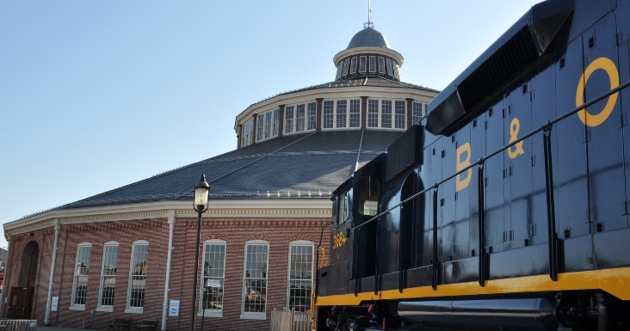
Capital Grants Overview
Currently, $1.4 billion in Capital Grants are funding 1,479 local infrastructure projects across the State.
  The 2019 Maryland Consolidated Capital Bond Loan (MCCBL) bill authorized 310 funding requests for local initiatives for a total of $193 million.

Slide 6

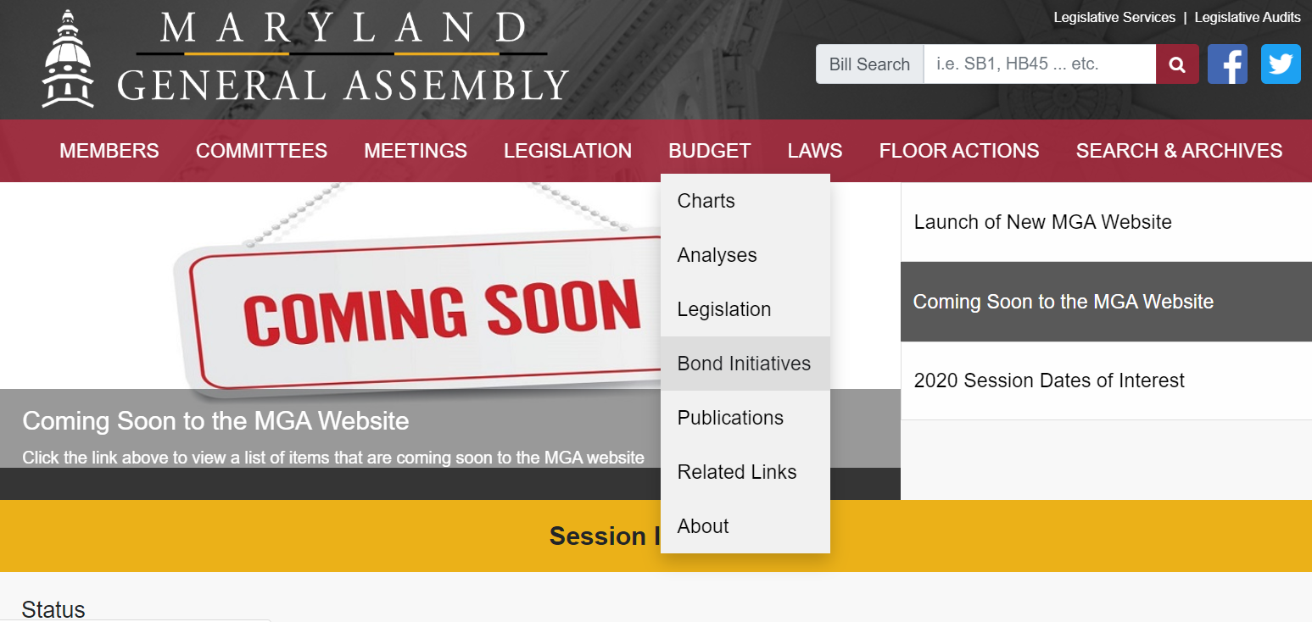
Capital Grant Projects: General Assembly Website
http://mgaleg.maryland.gov/mgawebsite

Slide 7
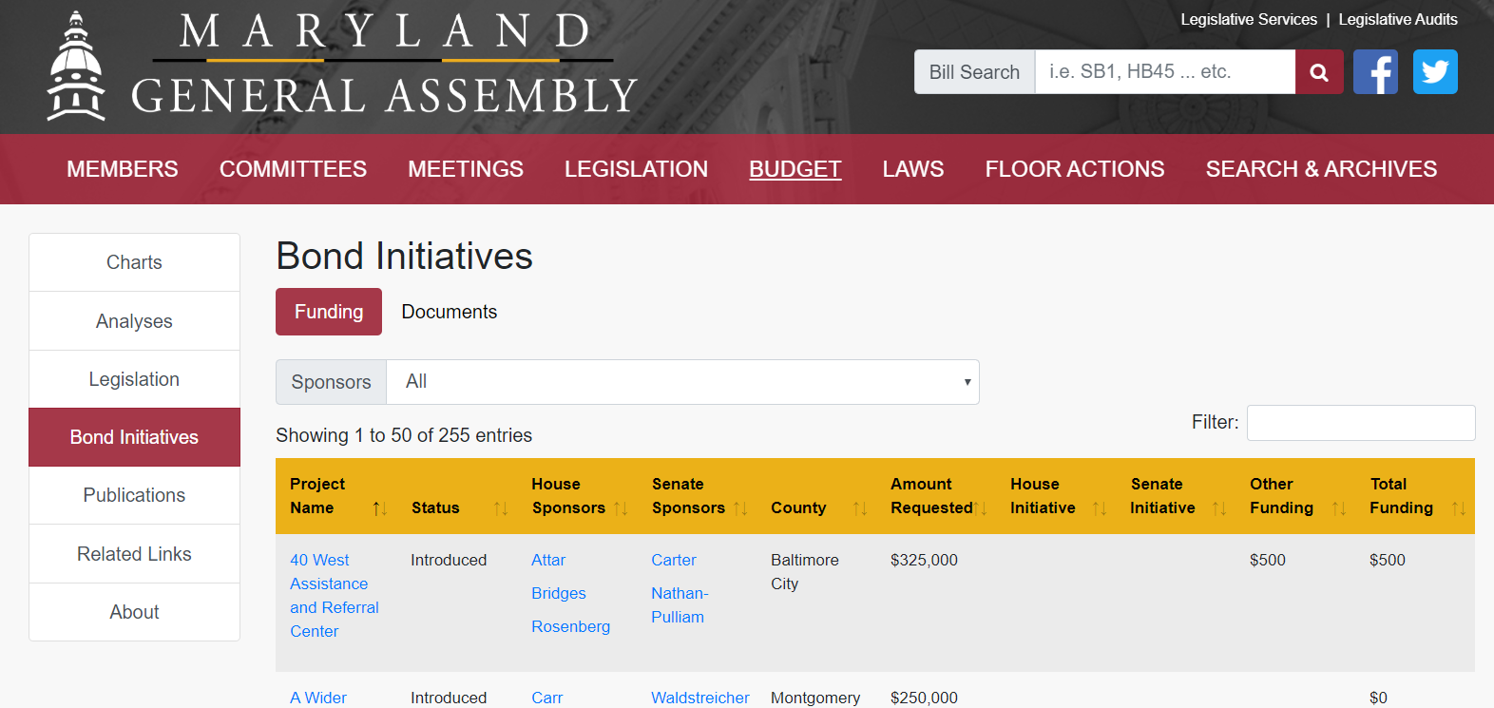
Capital Grant Projects: General Assembly Website
http://mgaleg.maryland.gov/mgawebsite/Budget/BondInitiatives

Slide 8
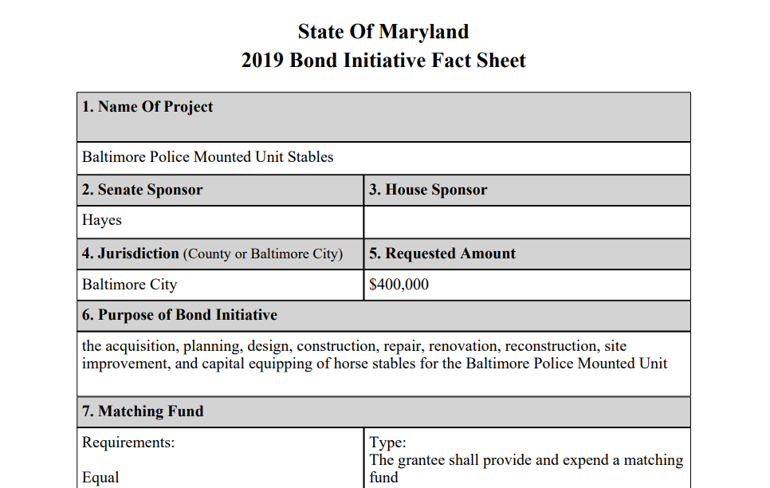
Capital Grant Projects

Slide 9
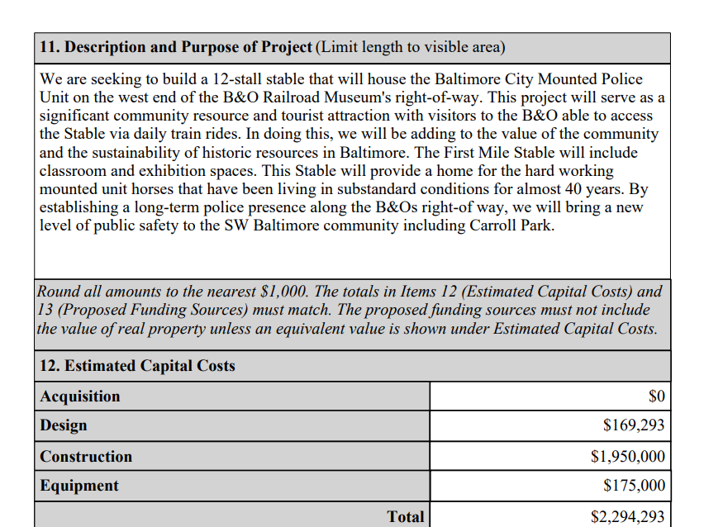
Capital Grant Projects

Slide 10
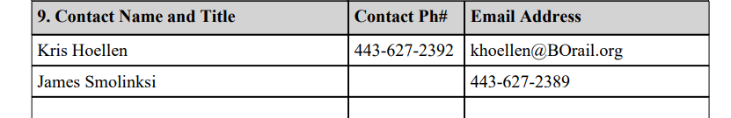
Capital Grant Projects
Contracting Opportunities
Grant recipients are responsible for hiring contractors to work on capital projects.
Contact information is available for all grantee organizations in the Bond Bill Fact Sheet.

Slide 11
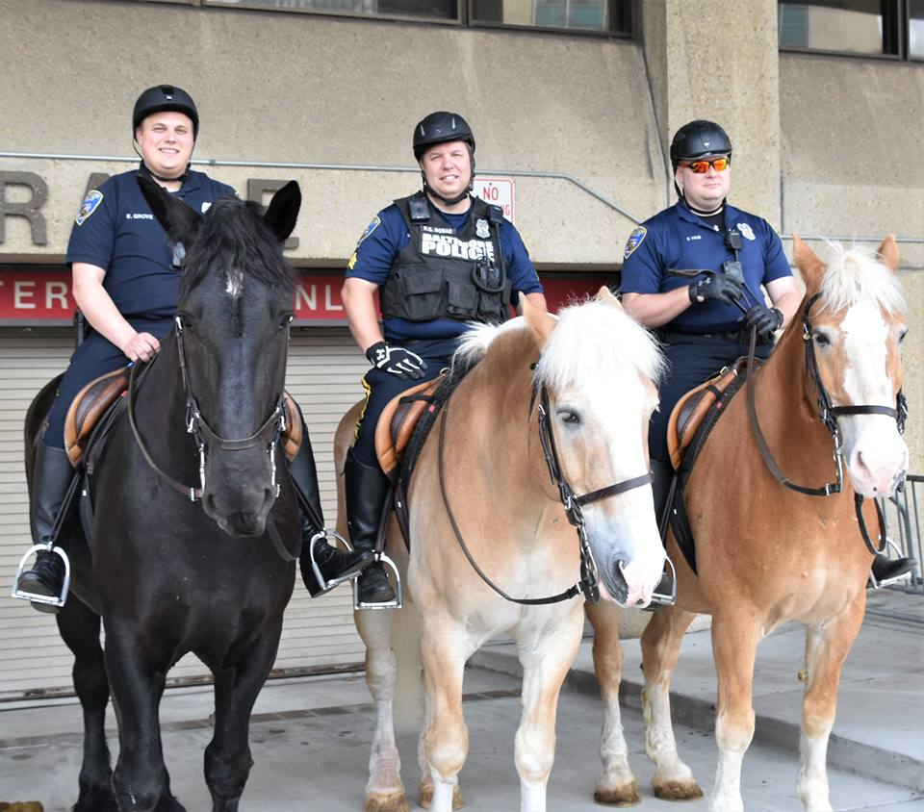
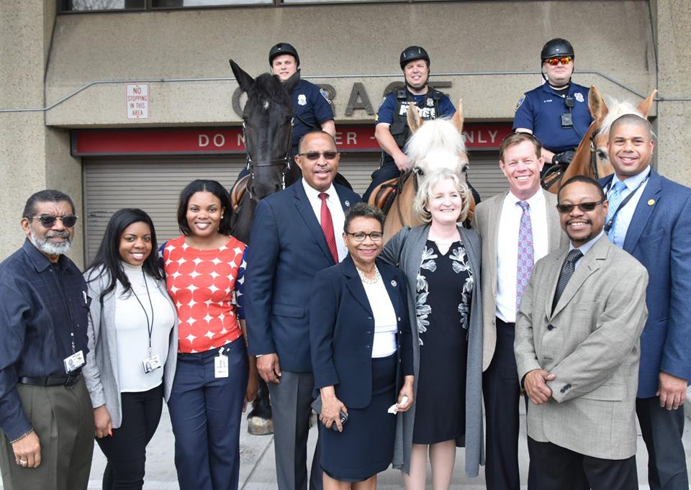
First Mile Stable Exhibit Opening

Slide 12
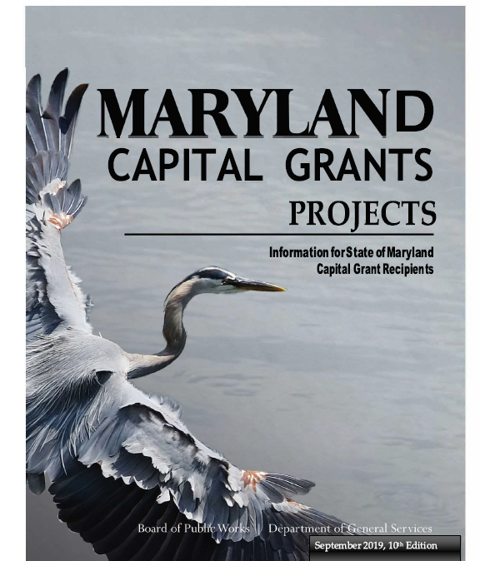
Capital Grant Policies & Requirements
Grant recipients are encouraged to follow State policies and requirements regarding the planning and implementation of capital projects funded by grants to avoid loss of grant funds.
The online Capital Grants & Loans (CGL) Booklet outlines these policies and requirements.
(https://dgs.maryland.gov/Documents/grants/cglbook.pdf)

Slide 13
Capital Grant Process
Step 1: Submit Your Grant Information
Step 2: Submit Your Procurement/Contract Information
Step 3: Submit Proof of Expending Your Matching Fund
Step 4: Submit Your Request for Payment
Step 5: Submit Your Project Closing Report and photographs

Slide 14
Step 1: Submit your Capital Grant Project Information
Capital Projects Grant Application Packet
  Complete the grant application ensuring the information is accurate and consistent with Bond Bill Fact sheet and Legislation.
  Evidence of Insurance Coverage
    Item of Grant-Funded Property with an original fair market value of $5,000 or more
    Grantee’s Insurer must be authorized to issue the policy in the State of Maryland
    Name the State as an additional loss payee
  Lease Agreement, if grant-funded property is not owned by the Grantee
  Acquisition of Real Property
  Affidavits (Lobbying and Religious Purposes)
  Maryland Historical Trust
Matching-Fund Documentation (if your bond bill requires a match)
  Hard Match
  Soft Match
Capital Projects Grant Agreement
Board of Public Works
  Approval of Grant Agreement
  Matching Fund Certification

Slide 15
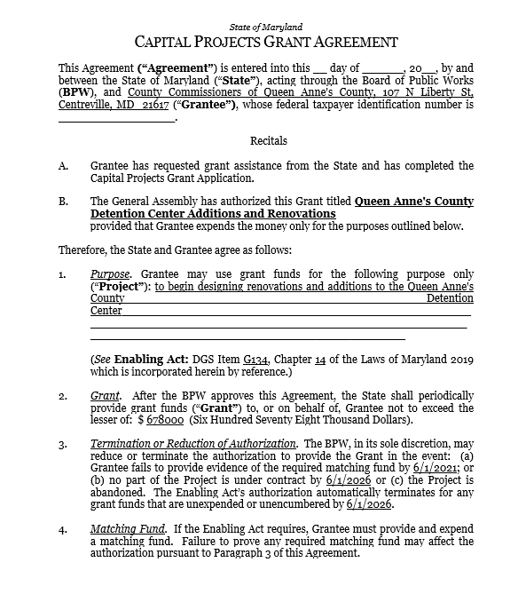
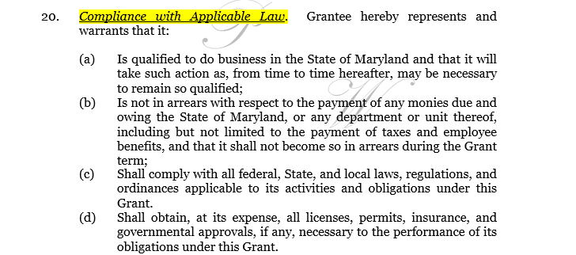
Grant Agreement: Compliance with Applicable Law
Your capital grant funds are governed by State Finance and Procurement Article §8-128, Annotated Code of Maryland

Slide 16
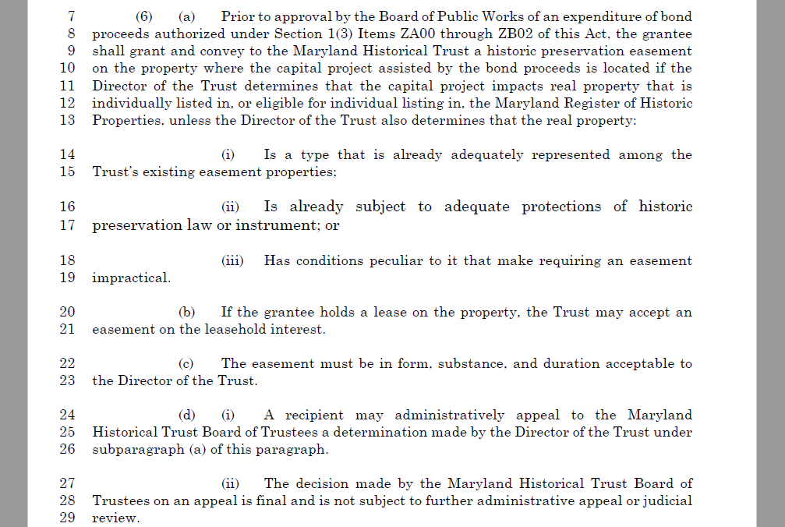
House Bill 101 Maryland Consolidated Capital Bond Loans:
Maryland Historical Trust
*Located in House Bill 101 on Page 86

Slide 17
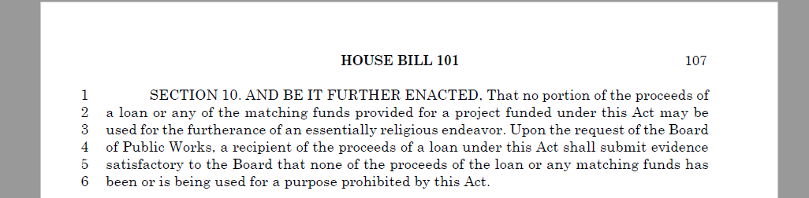
Compliance with Applicable Law: Religious Purposes
Located in House Bill 101 on Page 107

Slide 18
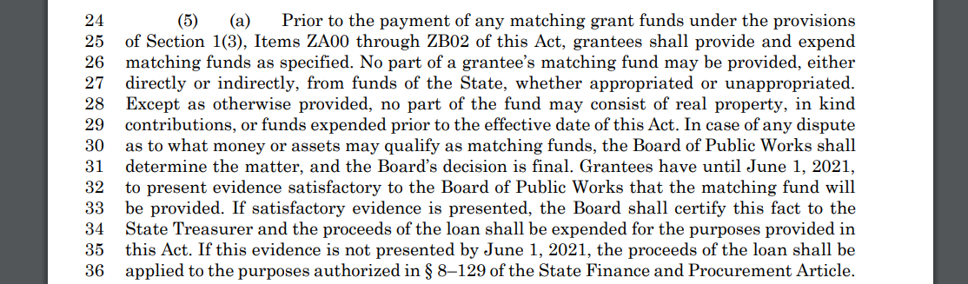
Compliance with Applicable Law: 2 Year Rule
Located in House Bill 101 on Page 85

Slide 19
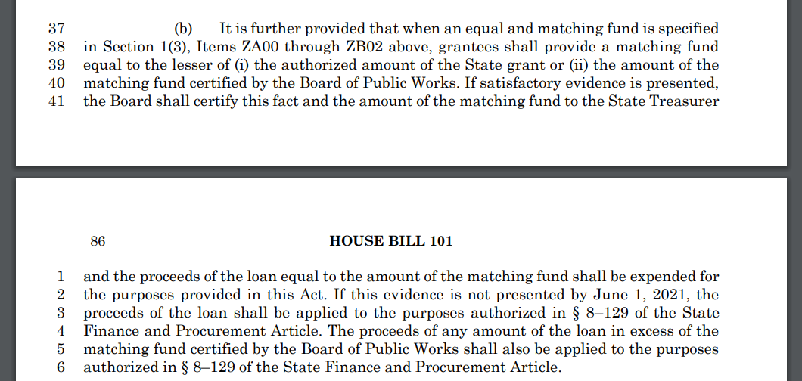
Compliance with Applicable Law: 2 Year Rule (Con’t)
Located in House Bill 101 on Pages 85 and 86

Slide 20
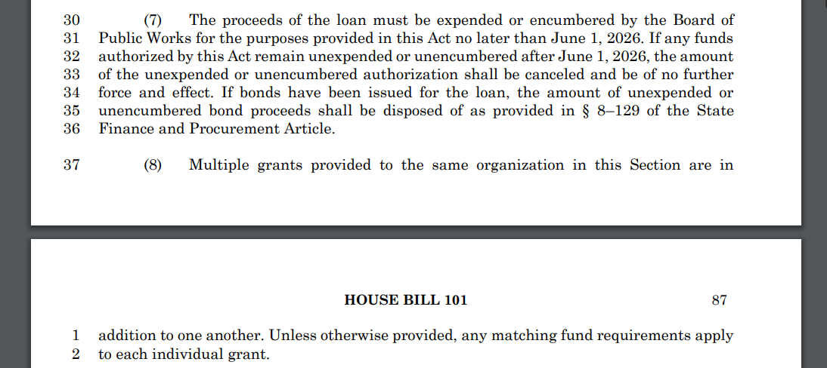
Compliance with Applicable Law: 7 Year Rule
Located in House Bill 101 on Pages 86 and 87

Slide 21
Step 2: Submit your Procurement/Contract Information
Eligible and Ineligible expenses: please see pages 15-18 of the Capital Grants Booklet
Procurement
  Grant recipients are encouraged to use a competitive procurement process when obtaining contractor services
  Solicitation process used for each contract
  Listing of Bidders (Name, Address and Bid Amount)
  Name of selected vendor (explanation of why the vendor was selected)
Contracts
  Name of the selected vendor and statement certifying that the selected contractor is not debarred or suspended and is registered to do business in the State of Maryland (www.bpw.state.md.us)
  Resident Businesses
    Grant recipients are encouraged to solicit Maryland resident businesses to design and construct grant projects.
  Minority Businesses
    Grant recipients are encouraged to solicit certified Minority Business Enterprises (MBEs) for all contracts. (mbe.mdot.Maryland.gov/directory)

Slide 22
Step 3: Submit Proof of Expending your Matching Fund*
Submit Matching Fund Claim Form (https://dgs.maryland.gov/Documents/grants/Match-funds.pdf)
Submit Contractor/Vendor invoices and receipts
Submit canceled checks and wire transfer documentation
Submit proof of fully expending federal or local government grants
Submit proof of conversion of stocks, bonds, CD’s, or other convertible cash items used as match funds
*100% of the matching fund must be expended

Slide 23
Matching Fund Claim Form

Slide 24
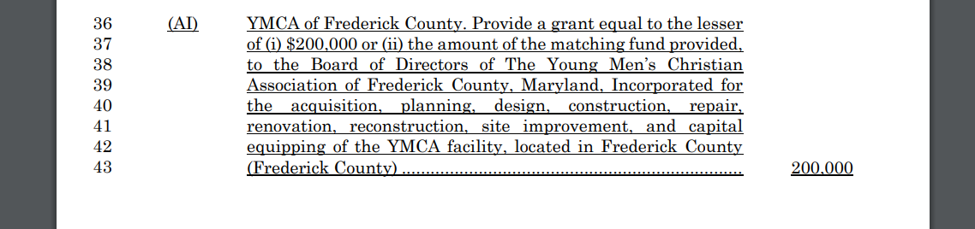
Hard Match

Slide 25
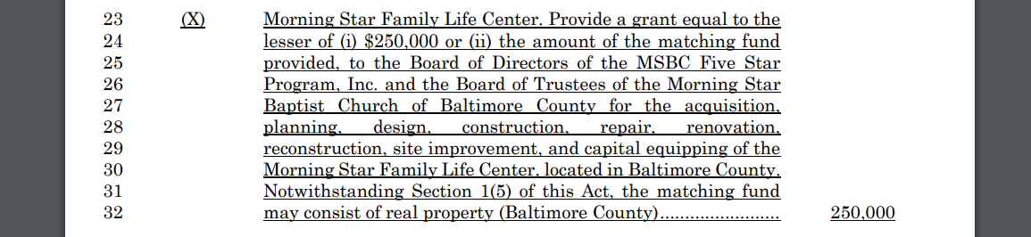
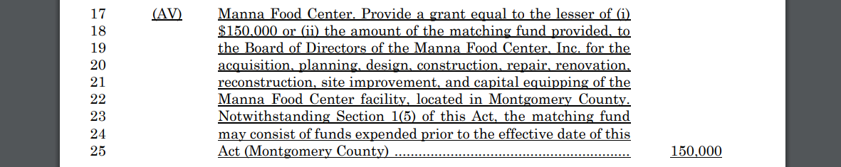
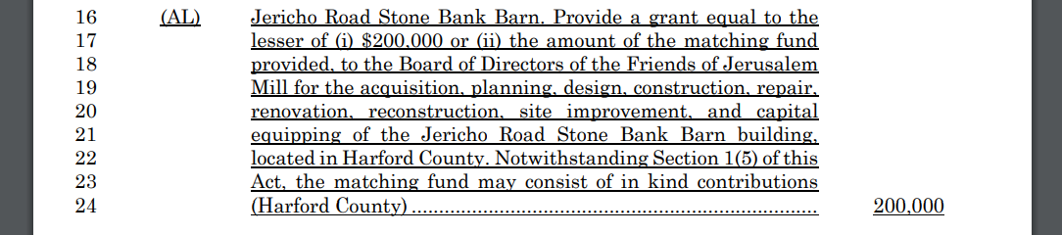
Soft Match:
Property
Soft Match:
Prior Expenditures
Soft Match:
In-Kind

Slide 26
Step 4: Submit your Request for Payment
Submit Grant Claim Form
  Attach a copy of Contract Eligibility letter
Payments made directly to vendors
  Schedule of invoices to be paid
  Original vendor invoices
  Vendor’s Federal Identification Number (IRS Form W9)
Reimbursements to Grantee Organization
  Schedule of paid invoices and corresponding check numbers
  Canceled checks (front and back)
  Copies of vendor invoices
  Organization’s Federal Identification Number (IRS Form W9)

Slide 27
DGS Payment Request Form
Comptroller’s Office Payment Request Form

Slide 28
Step 5: Submit your Closing Reports
Notify DGS Grant Administrator and the Comptroller’s Office, in writing, that the project has been completed
Submit your Capital Project Final Report to DGS
Submit pictures of the final project to DGS
Contact DGS Grants Compliance Officer to schedule an on-site or virtual visit to verify project completion

Slide 29
S Capital Grants Program Contact
Capital Grants & Loans Division
301 West Preston Street
Room 703
Baltimore, Maryland 21201
Linda Davis-Cole – Grants Coordinator (Information, inquiries and request for documents)
  dgs.capitalgrants@Maryland.gov
  (410)767-4390

Slide 30
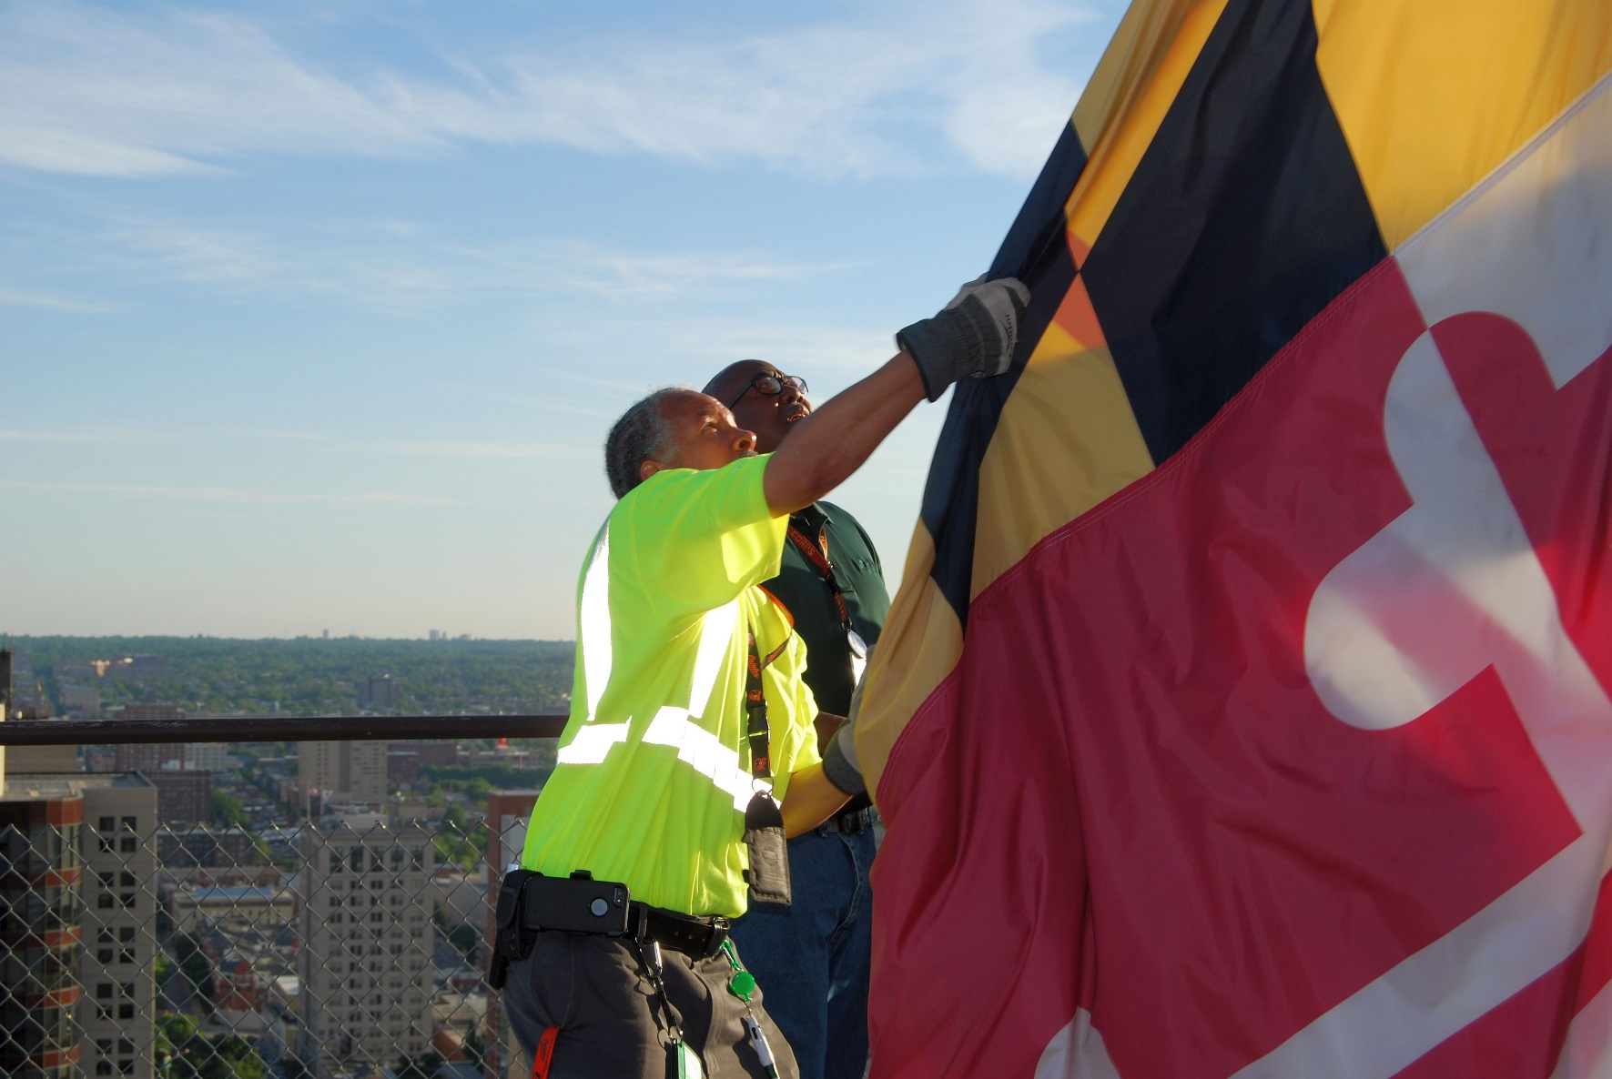
Questions & Answers
Thank you!

